Slide 1









Creative iMedia
R081: Pre-production skills
Revision Booklet

Slide 2


Mood boards
Purpose of a mood board:
Central focus of ideas in one place
Used to generate ideas for a client to meet their approval before creating the final product
Used to share ideas and concepts using examples
Content of a mood board:
Images
Colours
Text/fonts/styles/keywords
Textures, fabrics and other materials
Digital mood board = sounds and video clips

Slide 3
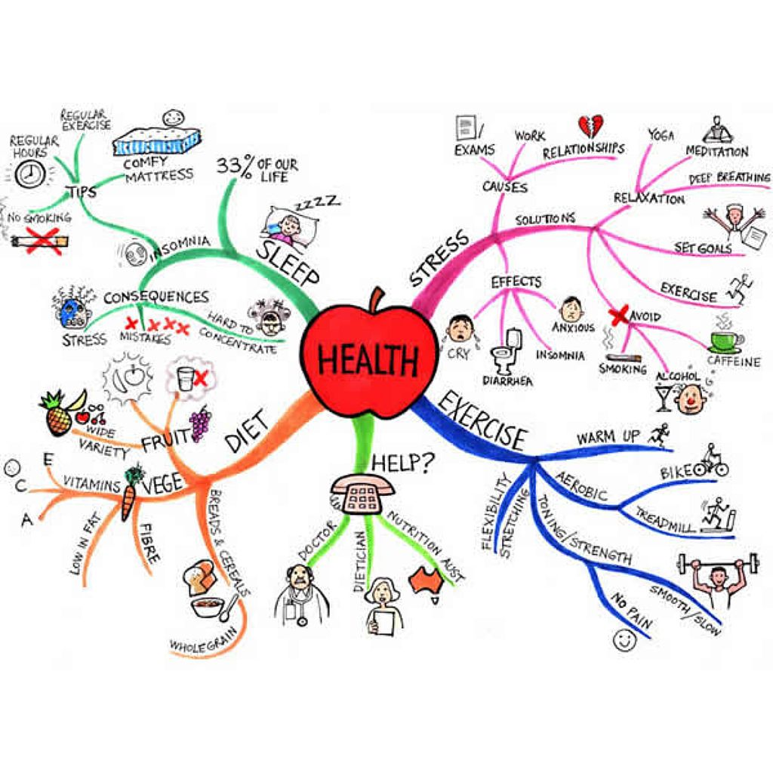
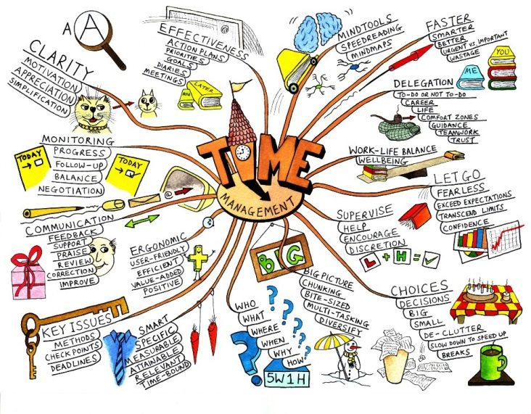
Mind maps
Purpose of a mind map:
Generate outline ideas quickly
Develop and show links between different thoughts, aspects and processes of a project
Content of a mind map:
Central node with the main theme
Sub-nodes with interconnecting lines/branches
Text
Images can also be used

Slide 4
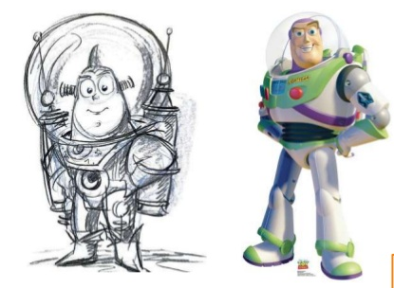
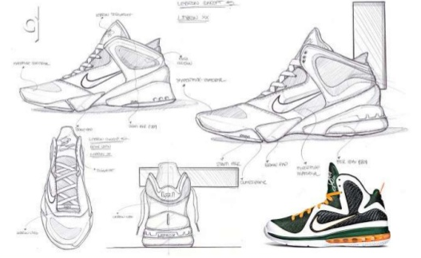
Visualisation diagrams
Purpose of a visualisation diagram:
Plan the layout of a still image in a visual manner
Show how the finished item may look
Content of a visualisation diagram:
Multiple images and graphics showing size and position
Colours and colour schemes
Position and style of text
Fonts to be used
Annotation providing more detail

Slide 5
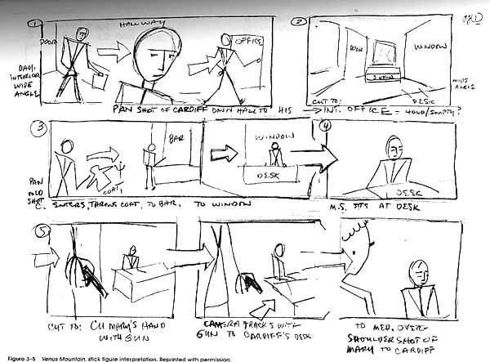
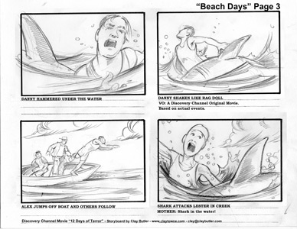
Storyboards
Purpose of a storyboard:
Provide a visual representation of how a media project will look along a timeline
Provide a graphical illustration of the sequence of movements
Provide guidance on what scenes to film or create
Content of a storyboard:
Images
Locations
Camera shot types and angles
Camera movement
Shot length and timings
Lighting
Sound

Slide 6
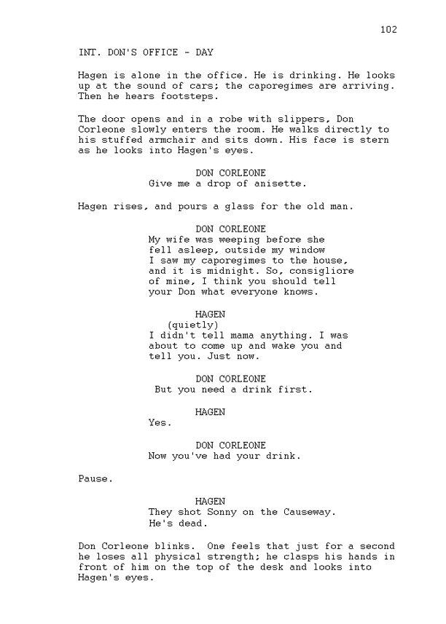
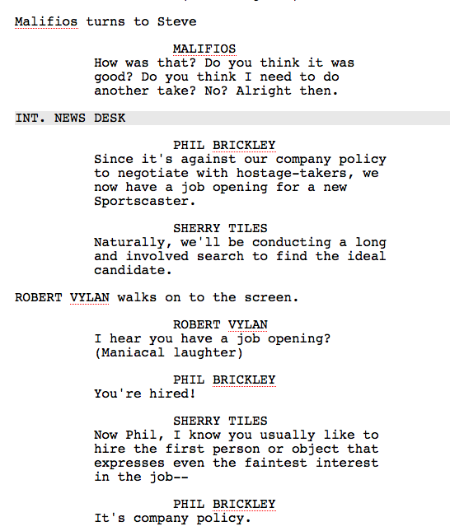
Scripts
Purpose of a script:
Identify the location where the action takes place
Identify who will be in the scene
Provide stage directions for actors and production crew
Provide dialogue for actors
Content of a script:
Set/locations
Scene descriptions
Scene/stage directions
Camera shot types
Camera movement
Sounds and sound effects
Names of actors/characters
dialogue

Slide 7

Client requirements
Whether you are creating something for yourself or for a client, your project will have a set of client requirements.
Purpose of client requirements:
Provide the media developer with outline information and any constraints (timescale)
Clear statement of what is to be produced
Content of client requirements:
Statement of what media product is needed
Purpose of the media product
Target audience
Content
Timescale
Restrictions
House style

Slide 8

Target audience
Who is the final product intended for?
Categories:
Age – need to be clear about the age group. (E.G. 6-12, 12-18, 18-40, 40+)
Gender
Location – local, national, international
Ethnicity – background, culture, race, religion, language
Research
Primary sources: the information is obtained first hand from an original source
Secondary sources: the information is obtained second hand where somebody else has created the data
Primary Sources | Secondary sources
Autobiography First-hand account Diary Interview Video footage Photo Official records | Biography Second-hand account History textbook Magazine article Report Other people’s products News broadcast

Slide 9
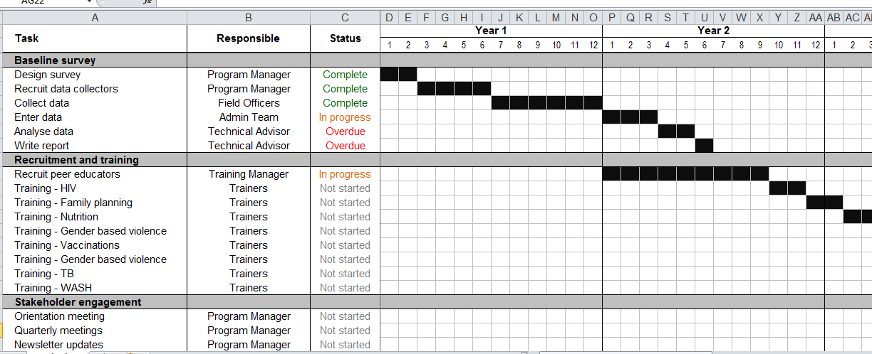
Work plans
Purpose of a work plan:
Provide a timescale for the overall project to be completed
To map out against time for all the different aspects of the project
Content of a work plan:
Tasks
Activities
Durations – amount of time a task is expected to take
Timescales – how long the project will take
Milestones – key dates when a section is completed
Deadlines – date when something has to be done by
Resources – what is needed
Contingencies – back up plan, extra time if needed

Slide 10
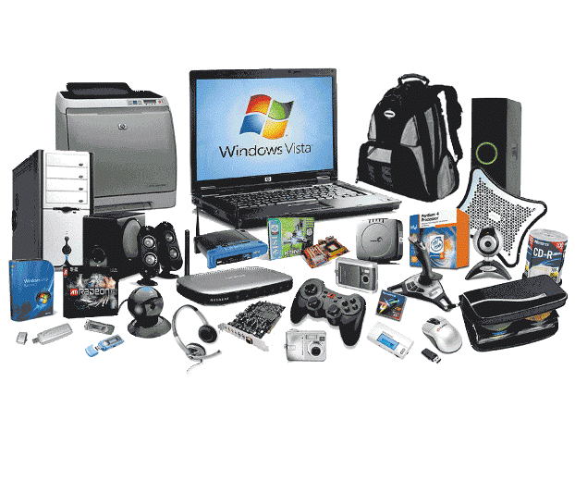
Hardware and Software
Hardware | Software
The devices and equipment that could used to create or digitise pre-production documents | Types of applications installed on a device that could used to create or digitise pre-production documents
Computer system Keyboard Mouse Graphics tablet Microphone Speakers Monitor Camera Scanner Pens/pencil/paper | Microsoft Office Publisher – used to create a mood board, storyboard, visualisation diagram MO Word – used to create a script, storyboard MO PowerPoint – used to create a mood board, visualisation diagram Web browser (IE, Chrome) Dedicated software – mind map, Dreamweaver

Slide 11
Health & Safety
Recce | A visit to a specific location that will be used for recording purposes. The purpose is to check access, see what is there, identify the best positions and assess environmental considerations. May include: Location Access Lighting Health & safety issues Availability of power Environmental considerations Any other issues
Risk assessment | Must be stored to cover you and any organisation that you work for in case of claims. Identify hazards and dangers Decide who might be harmed and how Evaluate the risks and decide on precautions to be taken Record findings and implement them Review assessment and update if necessary

Slide 12

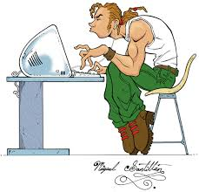
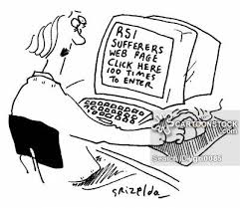
Health & Safety
Eye strain | Eyes can become strained after staring at a computer screen for a long time especially when working in bad light or with a poor screen Solutions: Use a screen filter Make sure you work in suitable light Don’t sit too close to the screen Take regular breaks (5 mins per hour) Have regular eye tests Have blinds available to avoid glare on the screen
Back pain | This can be due to poor posture or sitting in an awkward position Solutions: Use a fully adjustable chair Use footrests so that legs are at a natural angle Take regular breaks to walk around Don’t slouch Have the monitor at eye level
RSI | Repetitive Strain Injury is damage to the fingers and wrists due to repeated movements over a long period of time Solutions: Use wrist rests Regular breaks Ensure workstations are the correct height

Slide 13


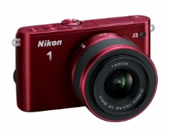
File formats
Video File Formats | MPG - Compressed file formats MOV – small file size MP4 – fats loading online
Audio File Formats | MP3 (compressed / small file sizes / good for devices) AIFF (uncompressed / high quality / Mac only) WAV (uncompressed / high quality / Windows only)
Image File Formats | JPG (lossless compression; photography) PNG (lossless compression; photography) TIF (large file sizes / Posters / high quality printing) PDF (un-editable/ Documents) GIF (small file sizes/ Online / web buttons)

Slide 14


Legislation
Copyright © & Trademarks ™ | If its published it has copyright protection ‘Published’ includes books, magazines, music, movies, all content on the internet. To use a published resources you must: Contact the owner Ask for permission to use it Often you will need to pay a fee
Copyright - Open licenses | Some people are happy for their products to be used by others but still want to have some protection. Creative Commons: A license agreement the creator chooses that lets you use that persons resources. However, you will still need to cite the source!
Certification | Different countries have laws on what is allowed to be seen and shown. Certification is the process of informing the audience broadly on the suitability of content. Certification is a major aspect when thinking about your target audience

Slide 15
Legislation
Data Protection | A series of UK laws designed to protect individuals and there personal data. Organisations can not collect and keep your personal information without following this law. Everyone has right to view and correct data. Data has to be accurate, for a specific purpose and secure.
Privacy | People have this right and it should not be invaded
Defamation | Can’t say nasty things about someone/an organisation without proof.

Slide 16
Exam Practice
Tick which type of pre-production document could be used for the media products listed in the table:
What might you see on a script that is not shown on a storyboard?
Shuttleworth College are holding a Summer Fair for the Community. At the summer fair will be many stalls, a BBQ and an ice cream van. You have been asked to create a visualisation diagram for a poster to advertise the Summer Fair to show the headteacher
 | Mood board | Mind map | Visualisation diagram | Storyboard | Script
Poster for festival
CD cover
Comic book
Company website
Computer game
Radio advert

Slide 17
Exam Practice 2
List THREE things that will be defined within the client requirements:
What might you see on a work plan?
What is the purpose of ‘contingencies’ on a work plan?
What legislation restricts an organisation storing information about its customers?
What legislation restricts an organisation copying and pasting images off the internet?
Identify THREE categories of a target audience
What could be used to digitise a hand drawn mind map?
What software could be used to create a mind map?

